Slide 1
HEALTHCONNECT CLINIC
WEEK 6
PROJECT SUMMARY
Data Analytics Track
Appointment Attendance & No-Show Analysis
Prepared by: Dawodu Fehintoluwa Bukola

Slide 2
01
What I Planned to Accomplish
Building directly on Week 5 rather than repeating it
DEEPEN
VALIDATE
IMPROVE
Investigate the strongest Week 5 patterns, especially booking lead time, previous no-show history and reminders.
Recheck the core appointment KPIs and assess whether Week 5 conclusions remain meaningful.
Upgrade the Power BI dashboard into a more focused analytical and decision-support view.
INTEGRATE
PREPARE
Use Data Science feedback and provide analytical findings relevant to predictive modelling.
Document limitations, decisions and requirements for Week 7 testing.
HealthConnect | Week 6 Project Summary • 2

Slide 3
02
What I Completed
Advanced analysis, KPI validation and dashboard development
ADVANCED ANALYSIS
KPI VALIDATION
DASHBOARD UPDATE
Investigated booking lead time, previous no-show history, reminder status/channel, appointment type, age group and appointment day.
Validated the three core Week 5 outcome KPIs: 48.46% no-show, 46.28% attendance and 5.26% cancellation.
Added deeper views of lead time, previous no-shows, reminders, appointment type and distance, plus clearer insights.
ANALYTICAL PRINCIPLE
The analysis identifies patterns and associations. An observed relationship does not establish causation.
HealthConnect | Week 6 Project Summary • 3

Slide 4
03
What Improved from Week 5
From descriptive reporting to advanced decision support
WEEK 5
WEEK 6
Initial exploratory analysis
• Overall appointment outcomes
• Basic segmentation
• Initial KPI development
• Initial dashboard
Deeper investigation
• Lead-time patterns
• Previous no-show history
• Reminder differences
• Appointment-type and distance views
• Clearer actions
THE PROGRESSION
Describe → Investigate → Validate → Translate into action
The dashboard now helps stakeholders explore which segments show higher no-show patterns and where further investigation may be most valuable.
HealthConnect | Week 6 Project Summary • 4

Slide 5
04
Cross-Track Integration
Data Analytics ↔ Data Science
RECEIVED
PROVIDED
INTEGRATED
Model improvement findings from comparing Logistic Regression, Random Forest and Gradient Boosting. Gradient Boosting produced the strongest overall performance, with approximately 65% accuracy, 65% no-show recall, 65% F1-score and 0.68 ROC-AUC
Findings on booking lead time, previous no-show history, reminder status and reminder patterns by appointment type
Compared analytical findings with model results and used them to identify/prioritise candidate predictive features and refine dashboard interpretation
WHAT CHANGED?
Booking lead time and previous no-show history were strengthened as priority variables for further predictive investigation and decision support; dashboard/recommendations were refined
HealthConnect | Week 6 Project Summary • 5

Slide 6
05
Key Findings & Development Outcomes
Evidence carried forward from the Week 6 analysis
NO-SHOW BURDEN
BOOKING LEAD TIME
PREVIOUS NO-SHOWS
No-shows remained the largest outcome: 48.46%.
Attendance decreased as booking lead days increased in this dataset.
Higher previous no-show history was associated with higher subsequent no-show rates.
REMINDERS
APPOINTMENT TYPE
AGE & DAY
Attendance differed by reminder status and channel; WhatsApp showed the highest attendance pattern among channels examined.
Follow-up appointments showed a higher attendance pattern than general consultation.
Age and appointment day did not show strong overall patterns in the analysis.
Interpretation: these are observed patterns in the dataset, not causal effects.
HealthConnect | Week 6 Project Summary • 6

Slide 7
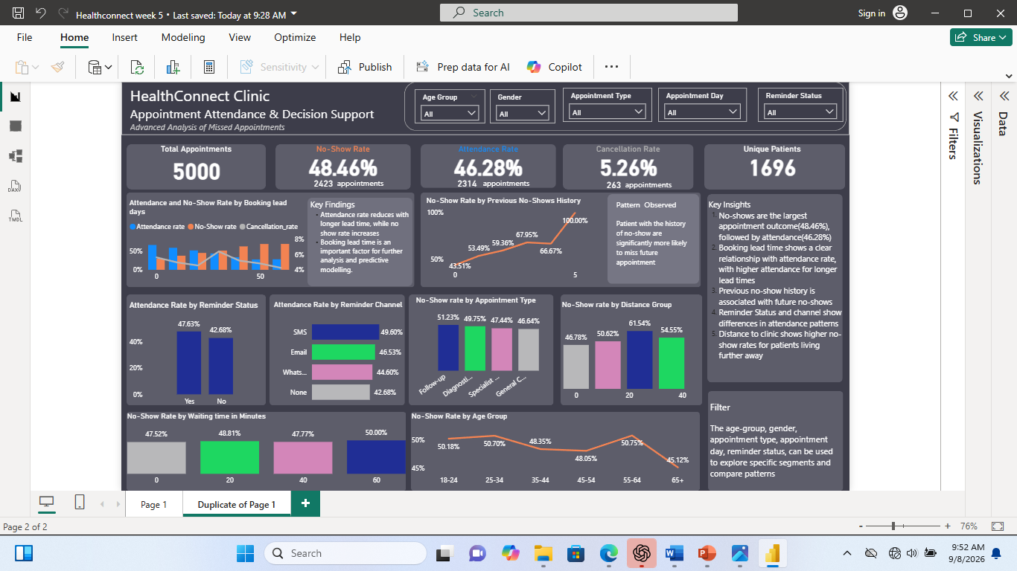
06
Dashboard / Visualisation
Updated Power BI decision-support dashboard
HealthConnect | Week 6 Project Summary • 7

Slide 8
07
Recommendations, Challenges & Decisions
Responsible actions based on current evidence
RECOMMENDED ACTIONS
CHALLENGES / REMAINING ISSUES
1. Prioritise no-show reduction.
2. Review reminder coverage and channel performance.
3. Consider targeted follow-up for repeated no-show patterns.
4. Investigate booking lead-time patterns.
5. Improve completeness of distance and waiting-time data.
6. Continue monitoring attendance, no-show and cancellation KPIs.
• Missing distance and waiting-time values.
• Reasons for missed appointments are not captured.
• Some relationships need further validation.
• Risk of overinterpreting associations.
IMPORTANT DECISIONS
• Retain the validated core KPIs.
• Focus deeper analysis on high-value patterns.
• Use association-based language.
• Provide relevant findings to Data Science.
• Improve rather than rebuild the Week 5 dashboard.
HealthConnect | Week 6 Project Summary • 8

Slide 9
08
Contribution to HealthConnect & Week 7 Focus
Preparing the analysis for broader testing and refinement
MY CONTRIBUTION
WEEK 7 ANALYTICAL TESTING
The Week 6 work advances HealthConnect from descriptive appointment analysis toward evidence-based decision support.
It provides validated KPIs, deeper attendance/no-show patterns, an improved Power BI dashboard and analytical inputs for predictive modelling.
• Validate key relationships using appropriate methods.
• Test dashboard calculations, filters and interactions.
• Review missing-data impact.
• Check stability of previous no-show patterns.
• Further evaluate reminder patterns.
• Confirm analytical inputs are suitable for Data Science.
Week 6 outcome: Improve → Integrate → Validate → Prepare for Testing
HealthConnect | Week 6 Project Summary • 9

Slide 10
09
Week 6 at a Glance
A concise summary of the required project outcomes
PLANNED
Deepen findings, validate KPIs, improve dashboard, integrate with Data Science.
COMPLETED
Advanced analysis, KPI validation, dashboard update and cross-track integration.
INTEGRATED
Data Analytics findings connected to Data Science modelling considerations.
CHANGED
Greater focus on lead time and previous no-show history for decision support.
KEY OUTCOME
No-show remains the main business challenge; several patterns warrant further validation.
REMAINING
Causality, missing variables and statistical validation remain limitations.
NEXT
Week 7 testing, validation and refinement.
HealthConnect | Week 6 Project Summary • 10

